Slide 1
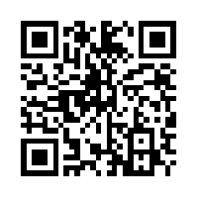
The Lost Tram (2007)
See how computers make mistakes “reading” texts!
Try it!

Slide 2
The North American Computational Linguistics Olympiad
www.naclo.cs.cmu.edu

Slide 3
CAN YOU GUESS THE LANGUAGE?
HINT #1: It’s spoken by nearly 65 million people in Southeast Asia.
HINT #2: Its writing system looks like this:
ตัวอักษรไทย
HINT #3: It’s closely related to Pali, Sanskrit, Lao, and the minority languages of Thailand.
Thai
Source: www.omniglot.com

Slide 4
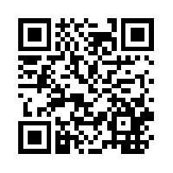
Springing up Baby (2008)
Don’t know Hindi? No problem! Learn how machine translation works by decoding the mystery words in this problem.
Try it!

Slide 5
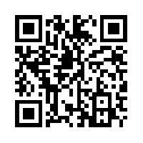
Fakepapershelfmaker (2008)
See how a data structure called a tree can help you understand Japanese.
Try it!

Slide 6
The North American Computational Linguistics Olympiad
www.naclo.cs.cmu.edu

Slide 7
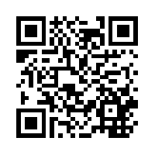
Thorny Stems (2008)
“Stemmers” help search engines work by chopping suffixes off of words (ex. walk, walking, walked…). Can you fix this one?
Try it!

Slide 8
Here are three phrases in Tajik, a language spoken in Tajikistan and Central Asia.
дуусти хуби хамсоай сумо a good friend of your neighbor
хамсоай дуусти хуби сумо a neighbor of your good friend
хамсоай хуби дуусти сумо a good neighbor of your friend
Thirty seconds left!
Can you match the Tajik words below to their English translations?
Hint: word order in Tajik and in English is not the same!
One minute left!
хамсоай
дуусти
хуби
сумо
good
friend
neighbor
your
Source: Adriana Solovyova

Slide 9
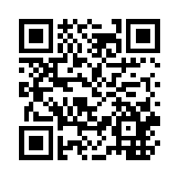
aw-TOM-uh-tuh (2008)
See how an abstract machine called a “finite state automaton” can help you identify the words of this New Guinea language.
Try it!

Slide 10
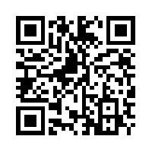
The Whole Spectrum (2008)
Learn the language of spectrograms.
Try it!

Slide 11
The North American Computational Linguistics Olympiad
www.naclo.cs.cmu.edu

Slide 12
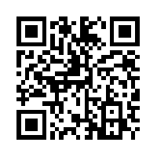
Nok-Nok! (2009)
Christopher Robin needs help with spelling. Can you figure out how his spelling checker works?
Try it!

Slide 13
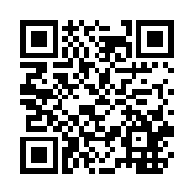
Help my camera! (2009)
This chat bot is not making sense! Can you figure out how to fix it?
Try it!

Slide 14
DID YOU KNOW?
Not all languages have the same sounds! Let’s try some sounds not usually found in English.
Glottal stop – the sound in the middle of ‘uh-oh’
Retroflex – press the bottom of your tongue to the roof of your mouth, then let it go while saying ‘t’
Click – press the tip of your tongue to the roof of your mouth, hard, then let go

Slide 15
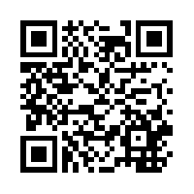
Sk8 Parsr (2009)
In this fictional video game, the moves can be pretty complex. But how complex can they get before they break the program?
Try it!

Slide 16
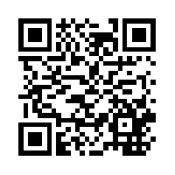
Orwellspeak (2009)
In a dystopian future, a repressive government tries to prevent people from saying false sentences.
Try it!

Slide 17
The North American Computational Linguistics Olympiad
www.naclo.cs.cmu.edu

Slide 18
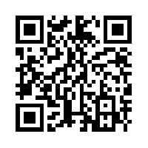
Texting, Texting, One, Two, Three (2010)
Learn about data compression while cracking an imaginary cell phone code.
Try it!

Slide 19
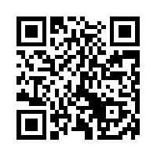
Dogs and Cats on Trees (2010)
Learn how computers parse, or break apart, sentences, and learn Malayalam (an Indian language) at the same time!
Try it!

Slide 20
CAN YOU GUESS THE LANGUAGE?
HINT #1: It’s an indigenous language of the United States.
HINT #2: Its writing system looks like this:
ᏣᎳᎩ ᎦᏬᏂᎯᏍᏗ
HINT #3: The name of the language, in the language, is Tsalagi.
Cherokee
Source: www.omniglot.com

Slide 21
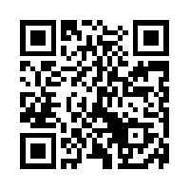
F u cn rd ths (2010)
The overworked employees in a call center have developed a strange writing system with abbreviations. Can you decipher it?
Try it!

Slide 22
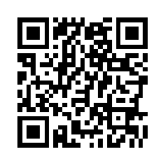
Real Money (2010)
This math puzzle would be a challenge in English… can you solve it in Quechua (a language from South America)?
Try it!

Slide 23
The North American Computational Linguistics Olympiad
www.naclo.cs.cmu.edu

Slide 24
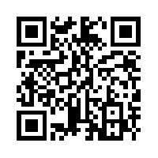
Khipu (2010)
Decipher an ancient Inca system of knots that was used for record keeping.
Try it!

Slide 25
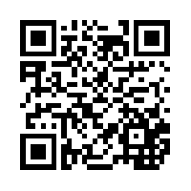
Running on MT (2011)
An automated translation program is making mistakes. Can you figure out why?
Try it!

Slide 26
Here are some sentences in Yaqui, a Native American language spoken in Arizona and Mexico, and their English translations in random order:
Inepo siika. Empo nee aniak. Inepo apo ’ik aniak.
Inepo apo ‘ik vichak.
Inepo enchi vichak.
Inepo enchi aniak.
Empo ye ‘ek.
Aapo enchi vichak.
A. You helped me. B. You danced. C. I saw you.
D. I saw him.
E. I helped you.
F. I helped him.
G. He saw you.
H. I left.
Thirty seconds left!
Two minutes left!
One minute left!
Can you match the Yaqui sentences to their English translations?
Source: Tom Payne

Slide 27
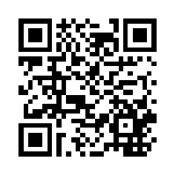
Interstellar First Contact (2012)
It’s the year 2354 AD, and we’ve finally managed to make contact with aliens. Can you use a peace message to translate from one alien language to another?
Try it!

Slide 28
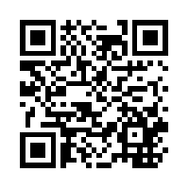
Waorani Numbers (2012)
Solve this math puzzle to learn how to count in the Waorani language of Ecuador!
Try it!

Slide 29
The North American Computational Linguistics Olympiad
www.naclo.cs.cmu.edu

Slide 30
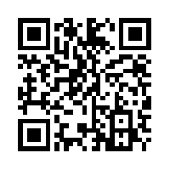
The Little Engine that Could… Read (2012)
Professor Monotone has a machine that can make inferences, but it’s broken. Can you fix it?
Try it!

Slide 31
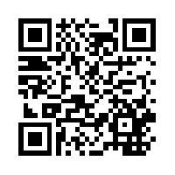
Jeg kan tælle (2007)
Can you figure out how to count in Danish?
Try it!

Slide 32
DID YOU KNOW?
There are over 7,000 languages spoken around the world.
Over 382 of those languages are spoken in the United States!
Greek
Vietnamese
Navajo
Persian
Hebrew
Mon-Khmer
French Creole
Spanish
Yiddish
Tagalog
Gujarati
Laotian
Armenian
Arabic
Polish
Thai
Hmong
Source: www.census.gov

Slide 33
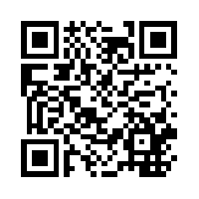
One, Two, Tree (2012)
How many meanings are there for this phrase: space mission control freak show? How can we use math to figure it out?
Try it!

Slide 34
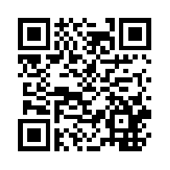
The Heads and Tails of Huffman (2013)
Deb and her friend Ahab encode their messages in the binary language of heads and tails, but they don’t have a lot of coins. How can they shorten their messages?
Try it!

Slide 35
The North American Computational Linguistics Olympiad
www.naclo.cs.cmu.edu

Slide 36
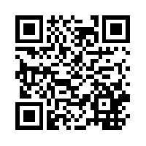
Grammar Rules (2013)
Learn how computers can analyze grammar using a notation system called context-free rules.
Try it!

Slide 37
CAN YOU GUESS THE LANGUAGE?
HINT #1: Its writing system is called Mkhedruli and looks like this:
HINT #2: It’s spoken in Georgia, Armenia, Azerbaijan, Iran, and other countries in the South Caucasus.
HINT #3: It shares the name of the main country where it’s spoken.
Georgian
Source: www.omniglot.com

Slide 38
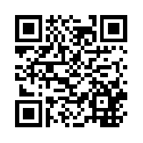
Twodee (2013)
Sometimes, the same sentence can have two or more meanings! Learn about a writing system designed to fix this problem.
Try it!

Slide 39
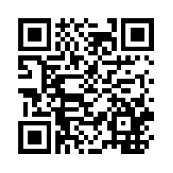
Yesbot (2013)
Can you make this slightly deranged chat bot smarter?
Try it!

Slide 40
The North American Computational Linguistics Olympiad
www.naclo.cs.cmu.edu

Slide 41
DID YOU KNOW?
English is written left-to-right, but not all languages are! Arabic is written right-to-left:
And Mongolian is written up-to-down!

Slide 42
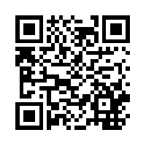
A Tree by Any Other Name (2013)
Use “decision trees” to explain the difference between phrases like “come up with” and “come down with”.
Try it!

Slide 43
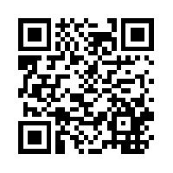
Grice’s Grifter Gadgets (2013)
You have a flying robot that helps you cheat at card games, but how can you program it to give you better hints?
Try it!

Slide 44
Here are some dates in Swahili, a language spoken in eastern Africa, and their English translations in random order:
Thirty seconds left!
One minute left!
Two minutes left!
Three minutes left!
tarehe tatu Disemba jumamosi tarehe pili Aprili jumanne tarehe nne Aprili jumanne
tarehe tano Oktoba jumapili
tarehe tano Oktoba jumatatu
tarehe tano Oktoba jumatano
A. Monday, October 5th B. Wednesday, October 5th C. Sunday, October 5th
D. Tuesday, April 2nd
E. Tuesday, April 4th
F. Saturday, December 3rd
Can you match the Swahili dates to their English translations?
Source: A. N. Zhurinsky, Valentin Vydrin

